Slide 1
Grammar in Backus-Naur Form (BNF)
expression -> binaryExpression
binaryExpression -> unaryExpression + binaryExpression
binaryExpression -> unaryExpression - binaryExpression
unaryExpression -> - simpleExpression
unaryExpression -> - simpleExpression
simpleExpression -> ( binaryExpression )
simpleExpression -> number
simpleExpression -> diceExpression
diceExpression -> number dSymbol number
diceExpression -> number dSymbol number selector number
number -> [1-9][0-9]*
dSymbol -> [Dd]
selector -> [Kk][Hh]|[Kk][Ll]|[Dd][Hh]|[Dd][Ll]

Slide 2
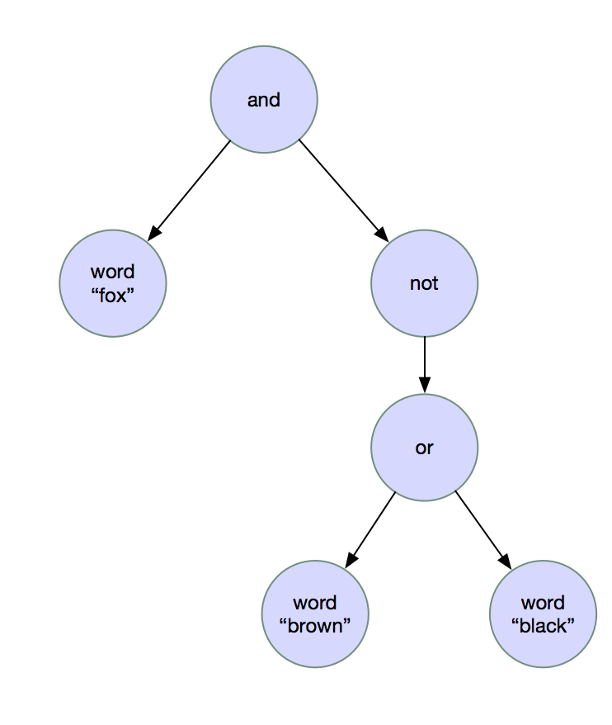
Syntax Trees
fox and not (brown or black)

Slide 3
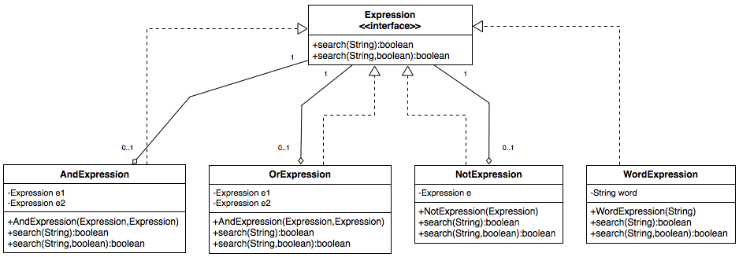
Object Model: Composite Pattern

Slide 4
Object Model: Composite Pattern
fox and not (brown or black)
Expression e = new AndExpression(
new WordExpression("fox"),
new NotExpression(
new OrExpression(
new WordExpression("brown"),
new WordExpression("black")
)
)
);
if (e.search(“The red fox raced across the road“)) {
System.out.println(“The specified string satifies the search expression“);
} else {
System.out.println(“The specified string does not satisfy the search expression“);
}

Slide 5
Building a Little Language Parser
The goal of our parser is to convert a string representing an expression such as “fox and not (brown or black)” into a composite object like the one we created programmatically in the previous slide.
The little language parser will be subdivided into two separate processes:
Lexical Analyzer: converts a sequence of characters into a sequence of language-specific terminal symbols.
Parser: converts a sequence of terminal symbols into a composite object.

Slide 6
Lexical Analyzer
Accepts a sequence of characters and converts them into a sequence of terminal symbols (a.k.a. tokens).
Each token has a type which can be expressed as a regular expression and a lexeme, which is the string that matched the regular expression for the token in question.
Token Types: AND, OR, NOT, LEFT_PAREN, RIGHT_PAREN, WORD, QUOTED_STRING, EOF
For an expression such as: “fox and not (brown or black)”, the sequence of tokens produced by consecutive calls to lexer.nextToken() are:
Token {type=WORD, lexeme=“fox”}
Token {type=AND, lexeme=“and”}
Token {type=NOT, lexeme=“not”}
Token {type=LEFT_PAREN, lexeme=“(”}
Token {type=WORD, lexeme=“brown”}
Token {type=OR, lexeme=“or”}
Token {type=WORD, lexeme=“black”}
Token {type=RIGHT_PAREN, lexeme=“)”}
Token {type=EOF, lexeme=null}

Slide 7
Parser
Uses a LexicalAnalyzer and top-down recursive descent to convert the tokens into a composite object based on the syntax rules defined for the grammar.

